Slide 1
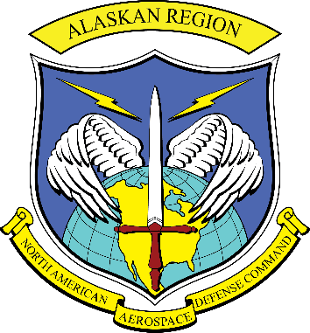
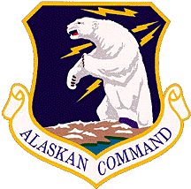

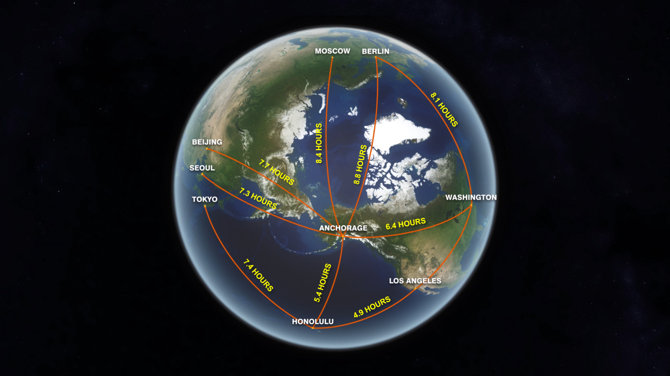
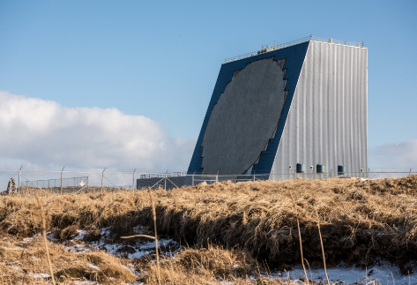
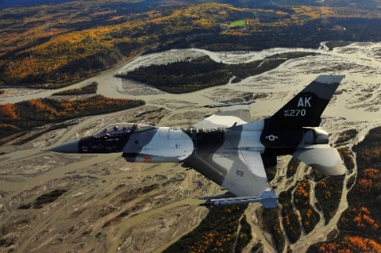
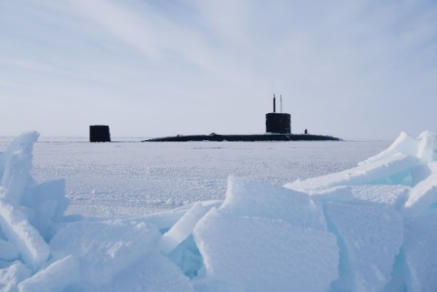
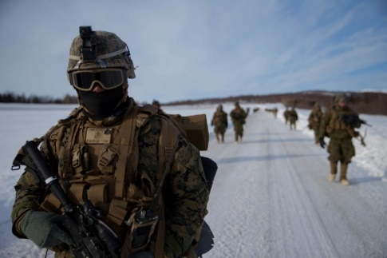
Alaskan NORAD Region
Bi-National (US and Canada)
Alaskan Command
Eleventh Air Force
Alaska is the most strategic place in the world – BG William "Billy" Mitchell, Testimony to Congress, 1935

Slide 2
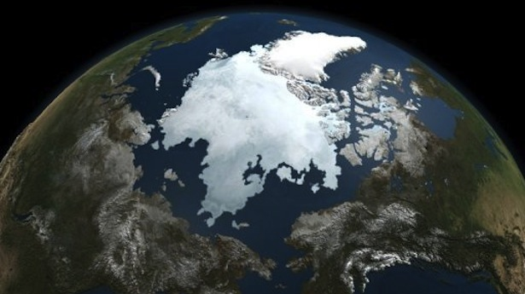
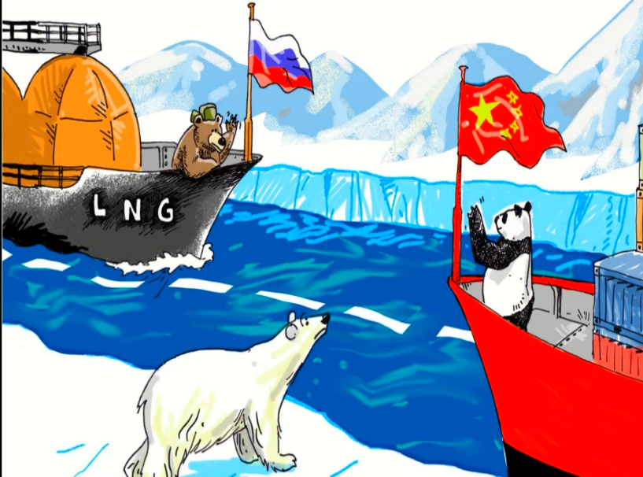
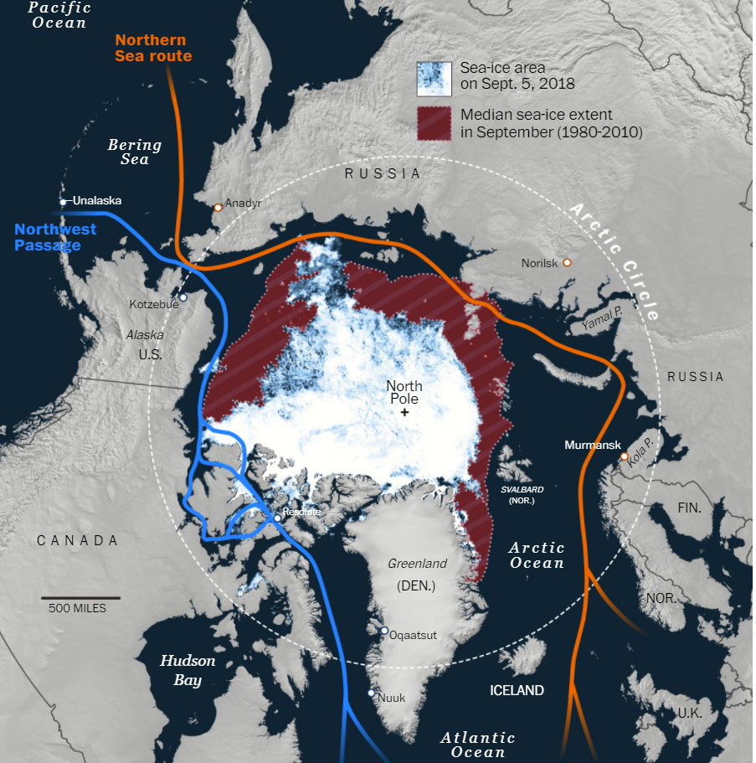
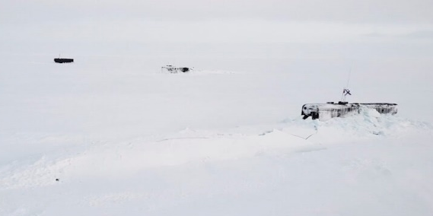
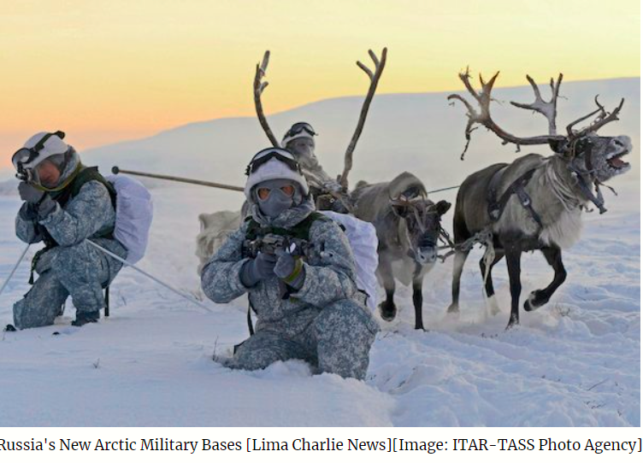
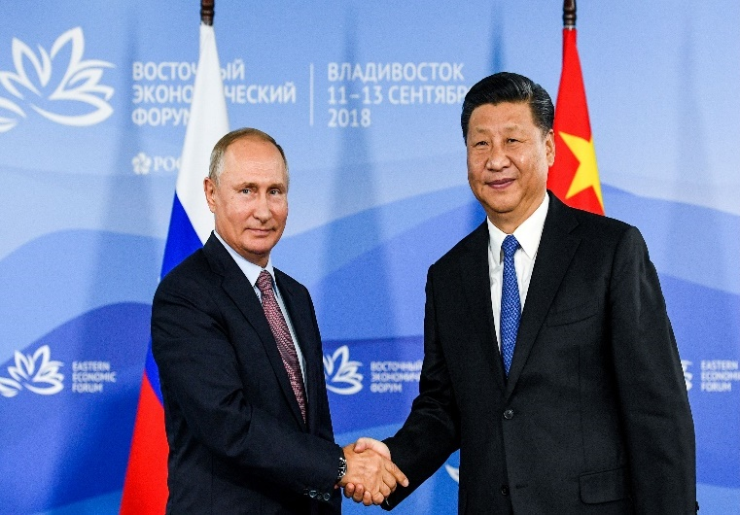
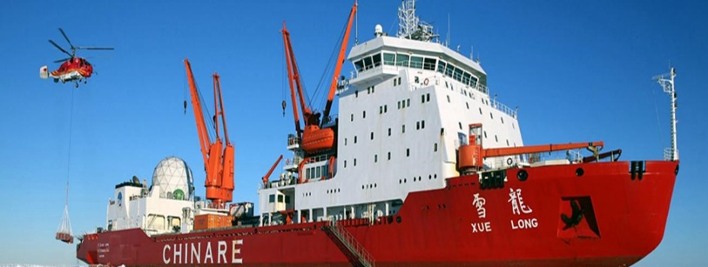
Great Power Competition
Three Russian missile-firing submarines surfaced in the Arctic during March 2021 exercise Umka-21. Image: Naval Post
Russia’s New Arctic Military Bases [Lima Charlie News] [Image: ITAR-TASS Photo Agency
Russian President Vladimir Putin shakes hands with Chinese President Xi Jinping (Donat Sorokin/Tass Host Photo Agency/Pool via Reuters)
China's research icebreaker Xuelong, or Snow Dragon. Photo taken 2017 from China Daily/Xinhua

Slide 3
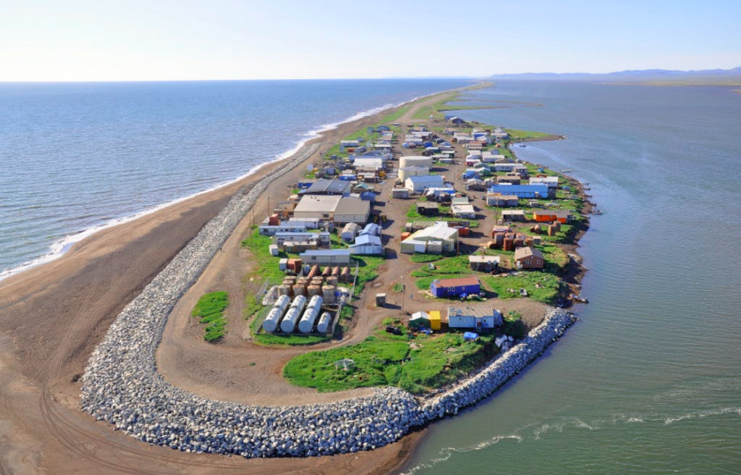
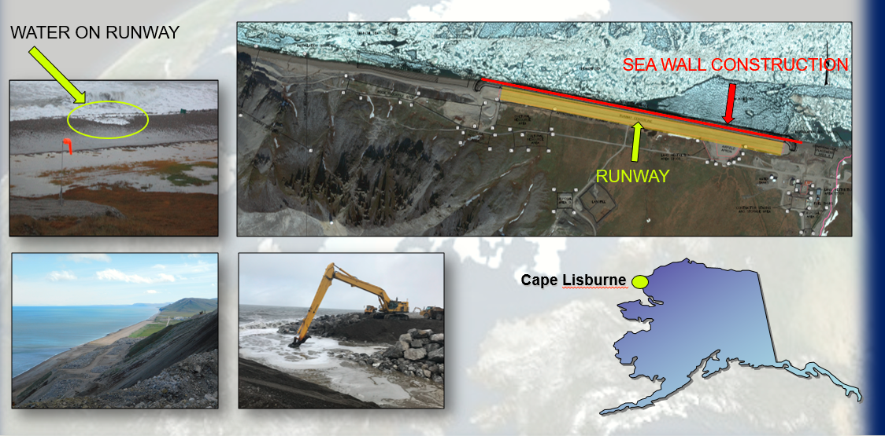
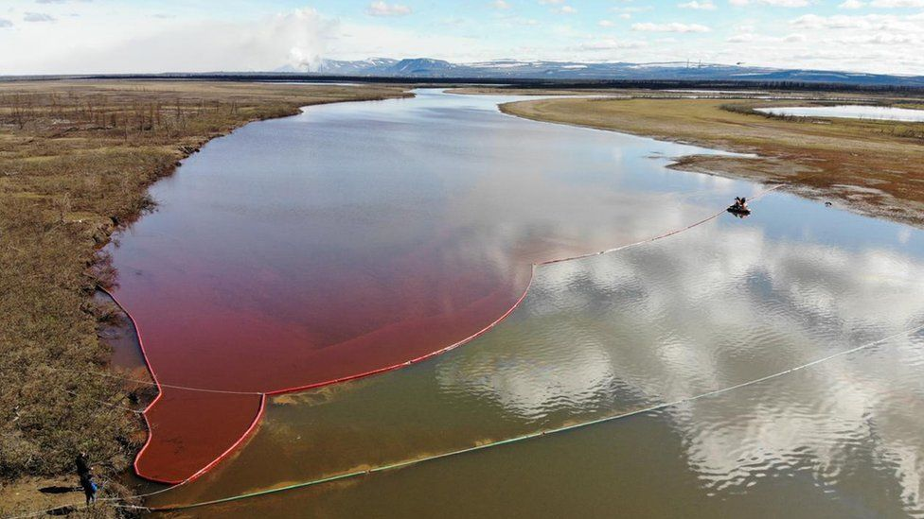
Implications of a Changing Arctic
This aerial shot of Kivalina, an Alaska Native Village facing shoreline erosion, was taken during the Kotzebue ShoreZone Survey.
Image source: ShoreZone
Cape Lisburne
Siberian city of Norilsk has entered a state of emergency after a power plant leaked 20,000 tons of oil into surrounding rivers on May 29, 2020. Thawing permafrost could have been responsible for damaging the oil tank
Cape Lisburne: shoreline has deteriorated at a rate far exceeding the anticipated annual rate in previous studies (severely damaged during a storm)

Slide 4

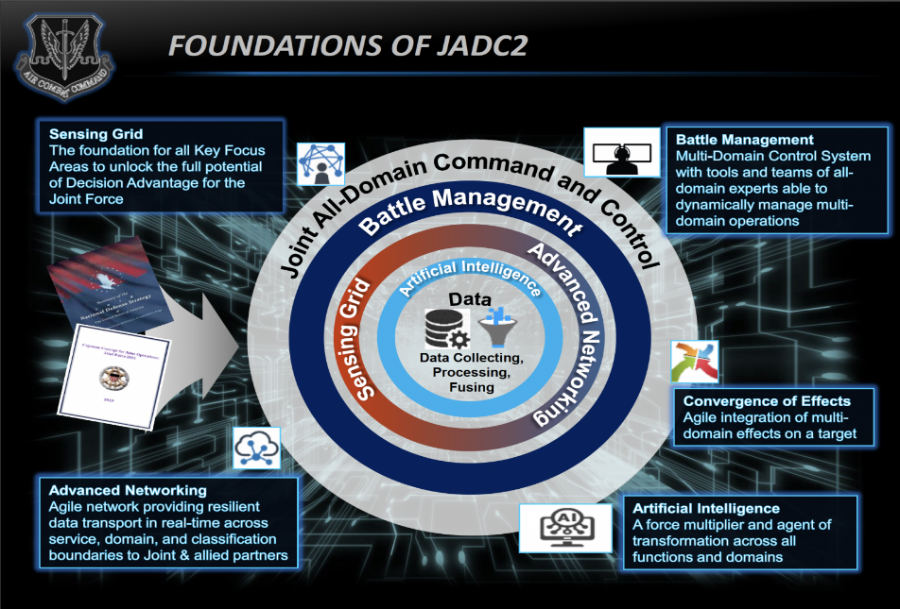
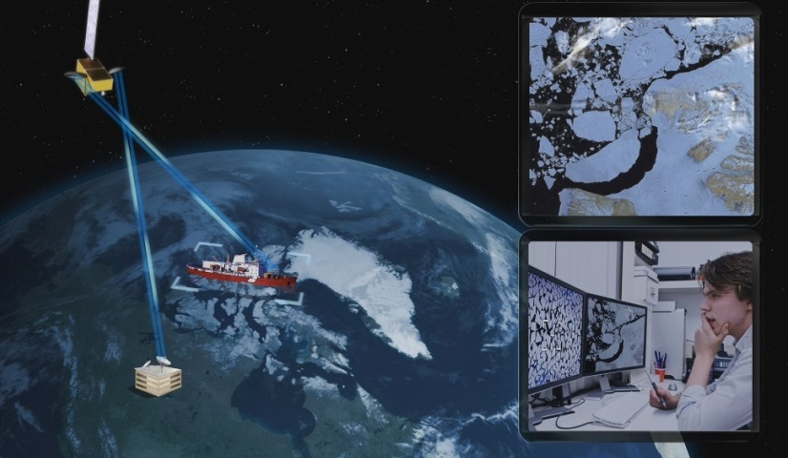
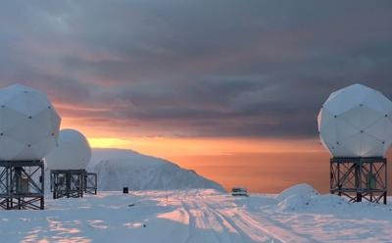
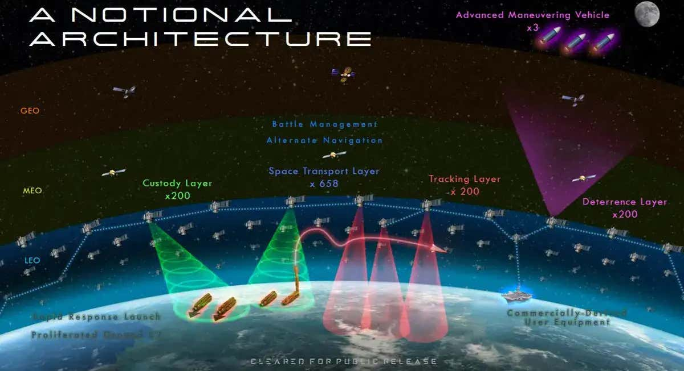
Enhancing Domain Awareness – Research Focus
Sea ice surveillance ,Polar Communications and Weather Project (CANADIAN SPACE AGENCY IMAGE)
Hughes and OneWeb selected by the U.S. Air Force Research Lab (AFRL) to demonstrate managed LEO satellite communications (SATCOM) services to connect the Arctic region to sites around the globe. By OneWeb

Slide 5
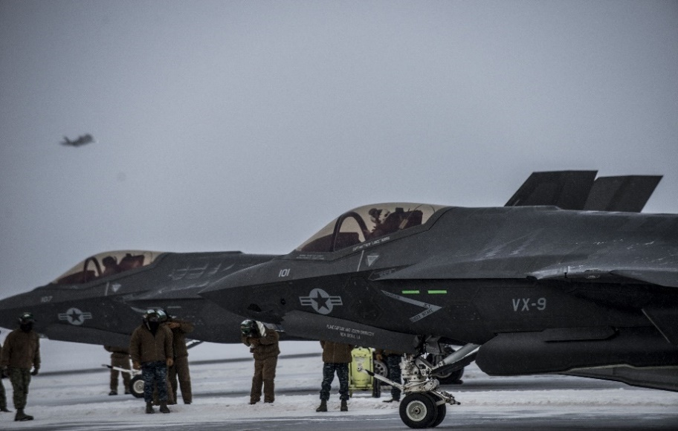
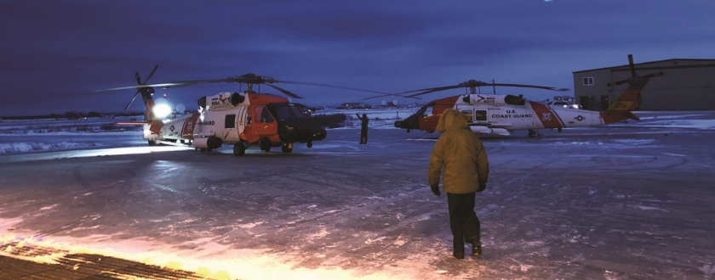
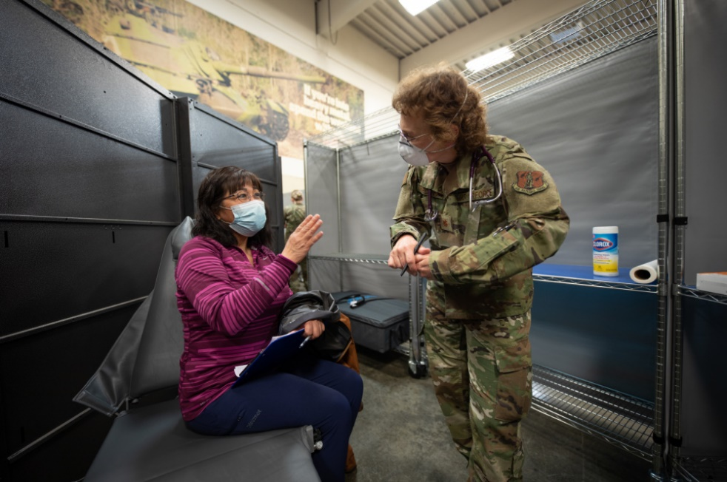
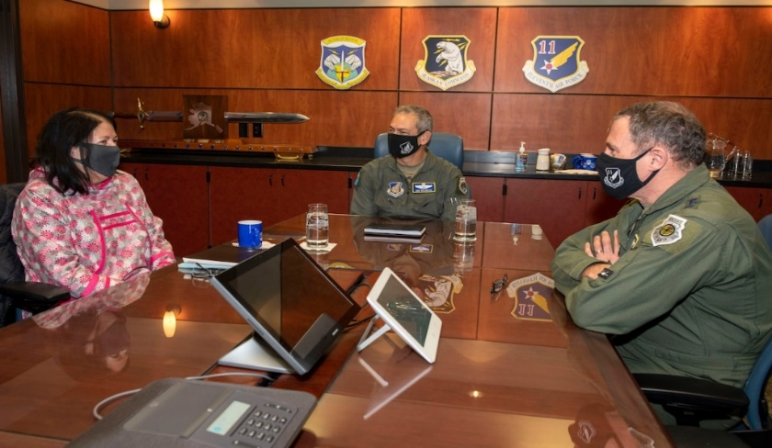
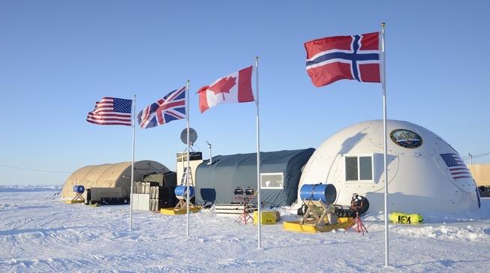
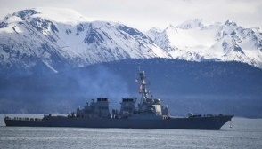
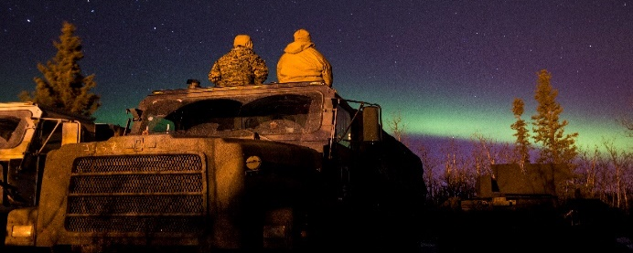
Leading in the Arctic

